Slide 1
Stock value prediction using
LSTM

Slide 2
Group Member Info:
Srujana Reddy Makutam – 700740914
Lnu Rumana Thaskeen – 700742859
Tejaswini Sankoju – 700726283
Kamala Ramesh - 700745451

Slide 3
Roles and Responsibilities:
Team Member 1 worked on the documentation for the project.
Team Member 2 worked on the data collection
Team Member 3 worked on the coding part
Team Member 4 worked on the references papers and helped in preparing the ppt

Slide 4
Motivation
Stock prices are inherently time-dependent and exhibit patterns over time. LSTMs, as a type of recurrent neural network (RNN), are designed to capture and model temporal dependencies, making them well-suited for time series analysis tasks like stock prediction.
LSTMs can effectively learn from historical price patterns and use them to make predictions, taking into account the sequential nature of the data.
LSTMs can automatically learn relevant features from the data, reducing the need for manual feature engineering. This can be particularly useful in stock prediction, where identifying relevant features from a large number of potential factors can be challenging.

Slide 5
Objective
Objective of stock prediction using Long Short-Term Memory (LSTM) is to develop a predictive model that can accurately forecast the future price movement of a stock or financial instrument.
Identify potential profit opportunities in the stock market. LSTM-based models aim to generate profitable trading signals,
Includes selecting appropriate evaluation metrics, tuning hyperparameters, and regularly updating the model to improve its accuracy and reliability.

Slide 6
Related work
Proposed an LSTM-based approach for stock price prediction, where LSTM models were trained on historical stock price data and used to predict future stock prices. The authors experimented with various LSTM architectures and hyperparameters,
Study utilized LSTM-RNNs to predict stock prices, considering both technical indicators and historical stock price data as inputs.
Research proposes an LSTM-based model combined with autoencoders for feature extraction to predict stock prices, incorporating both historical stock data and technical indicators.

Slide 7
Problem statement
Predicting stock values accurately is a challenging task due to the volatility of the stock market, the complexity of stock behavior, and the large amount of data involved.
Crucial for investors, traders, and financial institutions as it can help them make informed decisions and maximize their profits.
The problem statement for stock value prediction is to develop a predictive model that can accurately forecast the future values of stocks based on historical data, market trends, and other relevant factors.

Slide 8
Proposed Solution
Proposed framework for stock prediction using Long Short-Term Memory (LSTM), which is a type of recurrent neural network (RNN) commonly used for sequence data prediction tasks.
Collect historical stock price data, including features such as open, high, low, and close prices, as well as any other relevant data such as trading volume.
Extract relevant features from the stock price data that could potentially impact stock prices, such as technical indicators (e.g., moving averages, RSI), market sentiment, or external factors (e.g., economic indicators, news sentiment).

Slide 9
Design the LSTM model architecture. This typically involves defining the number of LSTM layers, the number of LSTM units (nodes) in each layer, and the activation function.
Train the LSTM model using the training data. During training, the model learns to capture patterns and relationships in the historical stock price data, which can help it make predictions on unseen data.
In order to prevent over-fitting of the data and speed up the training process, a dropout value of 0.3 has been fixed, meaning that 0.3 of the total nodes will be frozen during the training process.
Evaluate the trained LSTM model using the testing data. Calculate relevant evaluation metrics, such as mean squared error (MSE), root mean squared error (RMSE), and accuracy, to assess the model's performance.

Slide 10
Results
LSTM or any other technique is inherently uncertain, as stock prices are influenced by numerous factors and are subject to change due to market dynamics.
Accuracy of the predictions may vary depending on the quality and quantity of data, the architecture and hyperparameters of the LSTM model, and the dynamic nature of the stock market.
Model is trained on historical stock price data and relevant financial indicators, such as trading volumes and market trends.

Slide 11
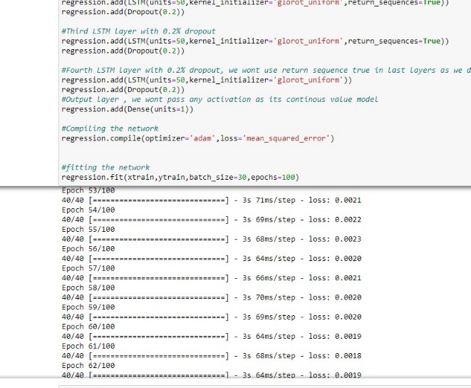
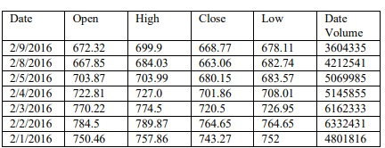

Slide 12
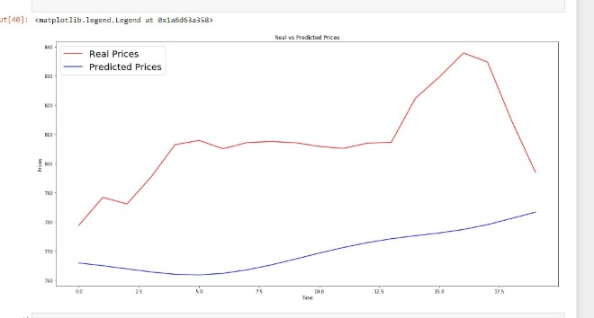
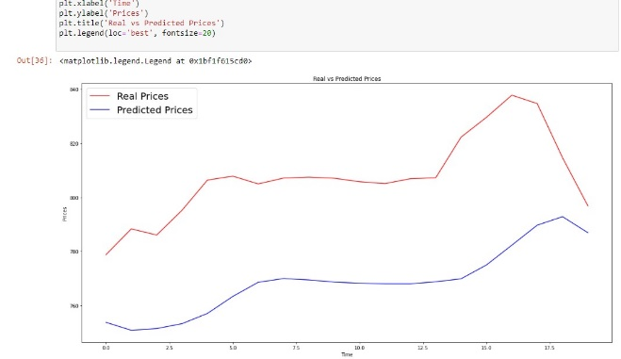

Slide 13
References
"Stock Market Prediction Using LSTM Recurrent Neural Network" by R. Tiwari and S. Srivastava.
"Stock Price Prediction using Deep Learning with LSTM and Autoencoders" by M. Ibrahim, R. Elazouni, and J. Qadir.
"Long Short-Term Memory Networks for Financial Time Series Prediction" by J. Chen, Z. Liang, and H. Du.
"Stock Price Prediction Using LSTM and Sentiment Analysis" by S. Jain, V. Agarwal, and P. Kumaraguru:
"Stock Market Prediction Based on LSTM Recurrent Neural Network" by N. Ntakaris, I. Kanniainen, and M. Gabbouj.

